Slide 1
Software Configuration Management
“Change is Inevitable”

Slide 2
SCM?
The art of coordinating software development to minimize confusion is called configuration management.
Configuration management is the art of identifying, organizing, and controlling modifications to the software being built by a programming team.
The goal is to maximize productivity by minimizing mistakes.

Slide 3
Purpose of SCM
Software configuration management (SCM) is an umbrella activity that is applied throughout the software process.
Because change can occur at any time, SCM activities are developed to
Identify change,
Control change,
Ensure that change is being properly implemented
Report changes to others who may have an interest.

Slide 4
Why SCM?
“ If you don’t control change, it controls you. ”
A stream of uncontrolled changes may turn a well-run software project into chaos.
SCM is an essential part of good project management and solid software engineering practice.

Slide 5
Why?
People come to know more about it, as time passes.
Most changes are justified.
First Law of System Engineering states:
“No matter where you are in the system life cycle, the system will change, and the desire to change it will persist throughout the life cycle.”

Slide 6
What is Software Configuration
The items that comprise all information produced as part of the software process are collectively called a software configuration.
Software Configuration Items (SCI)
Computer programs
both source level and executable forms
Documents (that describe the computer programs)
targeted at both technical practitioners and users
Data
contained within the program or external to it

Slide 7
Why change occurs?
New business or market conditions
Customer’s new needs
Or New Customer’s needs
Reorganization or business growth/downsizing
Budgetary or scheduling constraints
…….

Slide 8
Baseline
A baseline is a software configuration management concept that helps us to control change without seriously impeding justifiable change.
Definition :
“A specification or product that has been formally reviewed and agreed upon, that there-after serves as the basis for further development, and that can be changed only through formal change control procedures.”

Slide 9
Baseline - purpose
Creation of a baseline is usually a milestone in the schedule.
The baseline is centrally controlled.
Everyone uses the same current baselines.
To change the baseline requires a formal process.

Slide 10
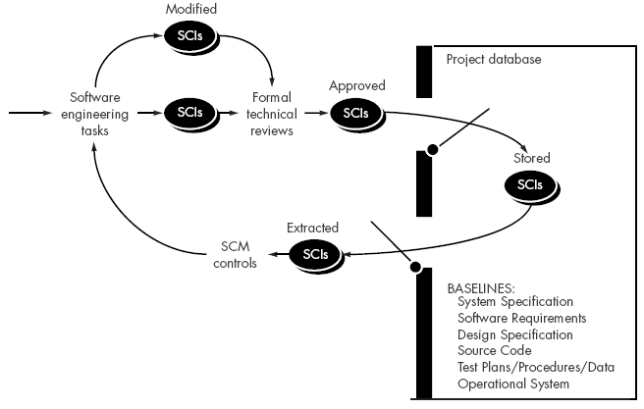
Baselined SCIs and Project Database (Software Repository or Project Library)

Slide 11
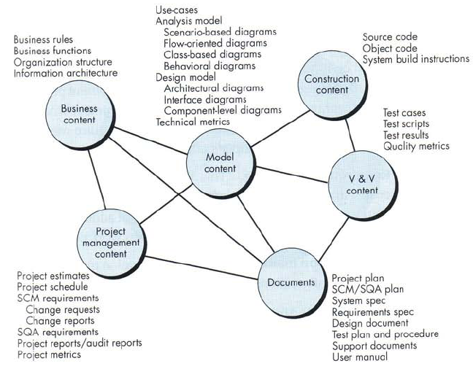
Content of the Repository
*Validation *Verification

Slide 12
Repository Functions
Versioning
Requirements
Tracing
Functions
Data integrity
Information sharing
Tool integration
Data integration
Methodology enforcement
Document standardization
SCM Repository
Dependency
Tracking
Configuration
Management
Change
Management
Audit Trails

Slide 13
Repository Functions
Versioning
Dependency Tracking and Change Management
Requirements Tracing
Forward Tracking : Ability to track all the design components and deliverables that result from a specific requirement
Backward Tracking : Ability to identify which requirement generated any given deliverable
Configuration management
keeps track of a series of configurations representing specific project milestones or production releases.
Audit trails
establishes additional information about when, why, and by whom changes are made.

Slide 14
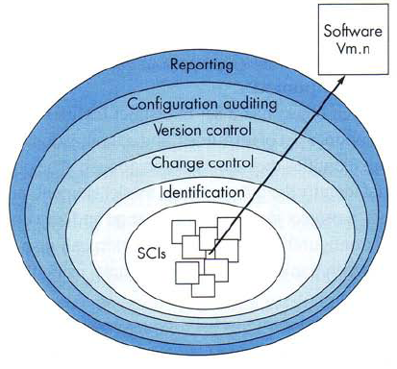
The SCM Process

Slide 15
The SCM Process (SCM Tasks)
Identification
How does an organization identify and manage the many existing versions of a program (and its documentation) in a manner that will enable change to be accommodated efficiently?
Change Control
* How can we ensure that changes have been made properly?
Version Control
How does an organization control changes before and after software is released to a customer?
Configuration Auditing
Who has responsibility for approving and ranking changes?
Reporting
What mechanism is used to appraise others of changes that are made?

Slide 16
The SCM Process : Identification
To control and manage software configuration items, each must be separately named and then organized using an object-oriented approach.
Two types of objects can be identified
Basic objects :
A basic object is a "unit of text" that has been created by a software engineer during analysis, design, code, or test.
For example, a basic object might be a section of a requirements specification, a source listing for a component, or a suite of test cases that are used to exercise the code.
Aggregate objects :
An aggregate object is a collection of basic objects and other aggregate objects.
Conceptually, it can be viewed as a named (identified) list of pointers that specify basic objects such as data model and component N (see fig. Configuration Objects).

Slide 17
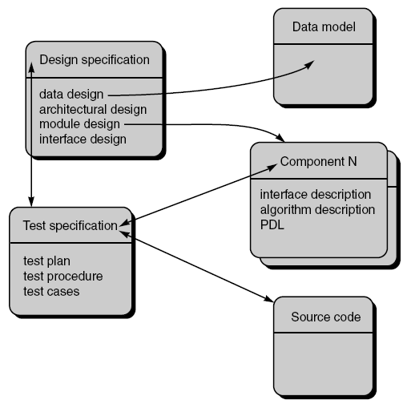
The SCM Process : Identification
Fig . : Configuration Objects

Slide 18
The SCM Process : Identification
Each object has a set of distinct features that identify it uniquely:
Name
The object name is a character string that identifies the object unambiguously.
Description
The object description is a list of data items that identify
the SCI type (e.g., document, program, data) represented by the object
a project identifier
change and/or version information
List of resources
Resources are "entities that are provided, processed, referenced or otherwise required by the object."
For example, data types, specific functions, or even variable names may be considered to be object resources.
Realization
The realization is a pointer to the "unit of text" for a basic object and null for an aggregate object.

Slide 19
The SCM Process : Version Control
Version control combines procedures and tools to manage different versions of configuration objects.
Configuration management allows a user to specify alternative configurations of the software system through the selection of appropriate versions.
This is supported by associating attributes with each software version, and then allowing a configuration to be specified [and constructed] by describing the set of desired attributes.
These "attributes" mentioned can be as simple as a specific version number that is attached to each object or as complex as a string of Boolean variables (switches) that indicate specific types of functional changes that have been applied to the system.

Slide 20
The SCM Process : Version Control
Consider a version of a simple program that is composed of entities 1, 2, 3, 4, and 5.
Entity 4 is used only when the software is implemented using color displays.
Entity 5 is implemented when monochrome displays are available.
Therefore, two variants of the version can be defined:
Entities 1, 2, 3, and 4;
Entities 1, 2, 3, and 5.

Slide 21
The SCM Process : Version Control
To construct the appropriate variant of a given version of a program, each entity can be assigned an "attribute-tuple”.
Attribute-tuple is list of features that will define whether the entity should be used when a particular variant of a software version is to be constructed.
One or more attributes is assigned for each variant. For example, a color attribute could be used to define which entity should be included when color displays are to be supported.
A new version is defined when major changes are made to one or more objects.

Slide 22
The SCM Process : Change Control
In large projects, uncontrolled change rapidly leads to chaos.
For such projects, change control combines human procedures and automated tools to provide a mechanism for the control of change.
A change request is submitted and evaluated to assess technical merit, potential side effects, overall impact on other configuration objects and system functions, and the projected cost of the change.
The results of the evaluation are presented as a change report, which is used by a change control authority (CCA)—a person or group who makes a final decision on the status and priority of the change.
An engineering change order (ECO) is generated for each approved change., which describes the change to be made, the constraints that must be respected, and the criteria for review and audit.

Slide 23
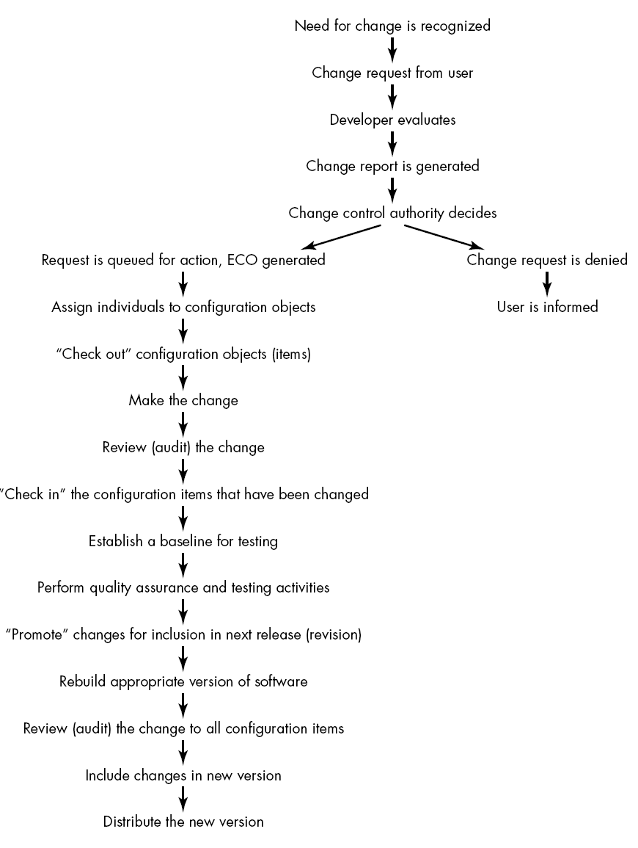
The SCM Process : Change Control

Slide 24
The SCM Process : Change Control
The object to be changed is "checked out" of the project database, the change is made, and appropriate SQA activities are applied.
The object is then "checked in" to the database and appropriate version control mechanisms are used to create the next version of the software.
The "check-in" and "check-out" process implements two important elements of change control
Access control and
Synchronization control.
Access control governs which software engineers have the authority to access and modify a particular configuration object.

Slide 25
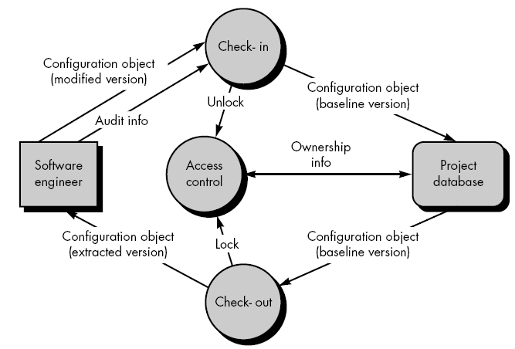
The SCM Process : Change Control
Synchronization control helps to ensure that parallel changes, performed by two different people, don't overwrite one another.
Access and synchronization control flow are illustrated schematically in following figure.

Slide 26
The SCM Process : Change Control
Based on an approved change request and ECO, a software engineer checks out a configuration object.
An access control function ensures that the software engineer has authority to check out the object, and synchronization control locks the object in the project database so that no updates can be made to it until the currently checked out version has been replaced.
Note that other copies can be checked-out, but other updates cannot be made.
A copy of the baselined object, called the extracted version, is modified by the software engineer.
After appropriate SQA and testing, the modified version of the object is checked in and the new baseline object is unlocked.

Slide 27
The SCM Process : Change Control
Prior to an SCI becoming a baseline, only informal change control need be applied.
The developer of the configuration object (SCI) in question may make whatever changes are justified by project and technical requirements (as long as changes do not affect broader system requirements that lie outside the developer's scope of work).
Once the object has undergone formal technical review and has been approved, a baseline is created.
Once an SCI becomes a baseline, project level change control is implemented. Now, to make a change, the developer must gain approval from the project manager (if the change is "local") or from the CCA if the change affects other SCIs.

Slide 28
The SCM Process : Change Control
When the software product is released to customers, formal change control is instituted.
Depending on the size and character of a software project, the CCA may be composed of one person—the project manager—or a number of people (e.g., representatives from software, hardware, database engineering, support, marketing).
The role of the CCA is to take a global view, that is, to assess the impact of change beyond the SCI in question.
How will the change affect hardware?
How will the change affect performance?
How will the change modify customer's perception of the product?
How will the change affect product quality and reliability?
….

Slide 29
The SCM Process : Configuration Audit
Even the most successful control mechanisms track a change only until an ECO is generated.
How ensure that the change has been properly implemented :
Formal Technical Reviews
The Software Configuration Audit.

Slide 30
The SCM Process : Configuration Audit
Formal technical reviews
The formal technical review focuses on the technical correctness of the configuration object that has been modified.
The reviewers assess the SCI to determine consistency with other SCIs, omissions, or potential side effects.
A formal technical review should be conducted for all but the most trivial changes.

Slide 31
The SCM Process : Configuration Audit
A software configuration audit complements the formal technical review by assessing a configuration object for characteristics that are generally not considered during review.
The audit asks and answers the following questions:
Has the change specified in the ECO been made? Have any additional modifications been incorporated?
Has a formal technical review been conducted to assess technical correctness?
Has the software process been followed and have software engineering standards been properly applied?
Has the change been "highlighted" in the SCI? Have the change date and change author been specified? Do the attributes of the configuration object reflect the change?
Have SCM procedures for noting the change, recording it, and reporting it been followed?
Have all related SCIs been properly updated?

Slide 32
The SCM Process : Configuration Audit
When SCM is a formal activity, the SCM audit is conducted separately by the quality assurance group.
Otherwise, the audit questions are asked as part of a formal technical review.

Slide 33
The SCM Process : Reporting
Configuration status reporting (or status accounting) is an SCM task that answers the following questions:
What happened?
Who did it?
When did it happen?
What else will be affected?

Slide 34
The SCM Process : Reporting
Each time an SCI is assigned new or updated identification, a configuration status reporting (CSR) entry is made.
Each time a change is approved by the CCA (i.e., an ECO is issued), a CSR entry is made.
Each time a configuration audit is conducted, the results are reported as part of the CSR task.
Configuration status reporting plays a vital role in the success of a large software development project, when many people are involved.

Slide 35
End
- Follow CM to “Avoid costly confusions”

Slide 36
Baseline - Basic Change Process
Change Request is made
Request is Approved or Denied
"Check Out" the item(s)
Make Changes
Testing or Reviews
formal review of design changes,
regression testing of modules, etc
Review the Change Order
Notify all Dependencies
when baseline change will occur
what changes were made to baseline
"Check In" the new baseline

Slide 37
Template for Baseline Change Requests
Name, Date, yadda yadda
Type of change
Goal of making the change
Priority / Urgency
Detailed description of the changes
Expected Effects
Timetable for making changes, testing, release,
Estimated Costs

Slide 38
CM Audits
% of unapproved changes
% of Change Orders completed on schedule
% of affected Configuration Items that were not checked
% of properly documented Configuration Items
number of CM Process Failures

Slide 39

Question
How do we keep track of all these versions, dependencies among components, approval records, etc. etc. etc., and still assure quality?
Have a Sound CM Procedure
Use Good CM Tools

Slide 40
CM Plan - Format
1. Introduction
a) purpose b) scope c) definitions and acronyms d) references
2. Management
a) organization
b) SCM responsibilities
c) interface control
d) SCMP implementation
e) policies, directives, procedures (naming conventions, version designations, problem report process)
3. SCM Activities
a) configuration identification
b) configuration control (change history, review authority, read/write control, member identification)
c) configuration status accounting (status of requests, status of approved changes, …)
d) audits and reviews
4. Tools, Techniques, and Methodologies
5. Supplier Control
6. Records Collection and Retention
According to
IEEE Standard 828 - standard for
Software Configuration Management Plans

Slide 41
IEEE 1042 Guide to Software Configuration Management
Defines terms, such as baseline and version
Discusses configuration management as a management discipline and its role in the engineering process
Includes checklists of issues for sections of the SCMP (IEEE Std 828)
Includes four complete examples of SCMPs

Slide 42

CM Tools - Necessary Features
Dependency Tracking!!!
Audit Trails!!!
Reporting of Changes
Supports the Change Rules
Versioning
Requirements Tracing
Repository arranged as "basic objects" and "aggregate objects"
Supports both Linear evolution and Trees

Slide 43
Closely Related Topic
Controlled Document - a document that is currently vital or may become vital for development and maintenance.
Galin page 389
Hence, its preparation and storage is an SQA issue.

Slide 44
Controlled Document QA Procedure
Definition of the list of Controlled Documents
Document preparation requirements
Document approval requirements
Document storage, retrieval, and versioning
Galin page 391

Slide 45
What Changes?
Software Code
Data
test data
database files
Documents
SRS
designs
project schedules
test plans, test results
…
Standard Term:
"Configuration Item"

Slide 46
Role of the Repository
Data Integrity
Ensure consistency
Perform “Cascading”
Information Sharing
Share information among multiple developers
Lock & unlock objects to avoid adverse changes
Tool Integration
tool integration establishes a data model that can be accessed by all tools
controls access to the data
Other obvious functions of a DBMS

